Slide 1
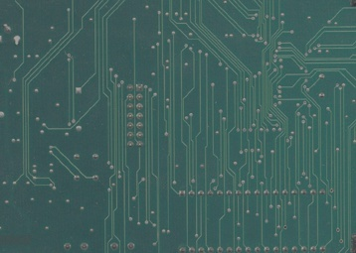
Operating Systems
Lecture#3
Types of processes,
System Calls,
Threads, Swapping,
Scheduling

Slide 2
Types of Processes/Process Initialization

Slide 3
Types of Processes/Process Initialization
Foreground processes
Interact with users and perform work for them
Application software have mostly foreground processes.
Background processes
Don't directly interact with users but have some specific functions.
Windows process are mostly background

Slide 4
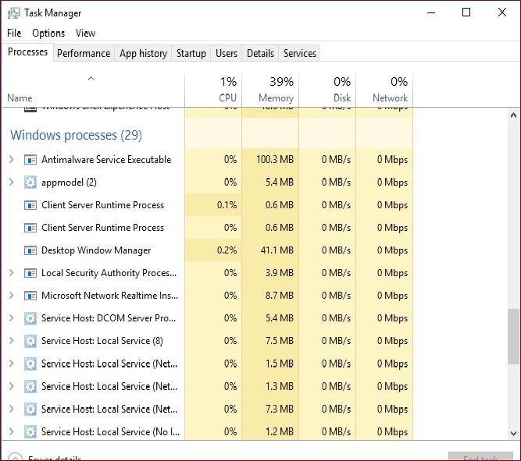
Background Processes

Slide 5
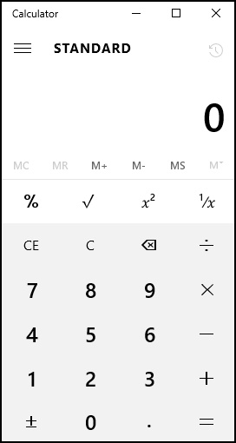
Foreground Processes

Slide 6
Difference between program and a Process
Program
A set of instruction to solve the problem.
Process
A program in execution.
Examples?
Food recipe is a program and making it is a process.

Slide 7
Kernel

Slide 8
Kernel
Definition: The “kernel” is a computer program that is the core of a computer's operating system, with complete control over everything in the system.

Slide 9
Kernel
It is The portion of the operating system that includes the important system functions.
It is the first program loaded on start-up. It handles the rest of start-up as well as input/output requests from software, translating them into data-processing instructions for the central processing unit.
It handles memory and peripherals like keyboards, monitors, printers, and speakers.

Slide 10
Important
When a process makes requests of the kernel, it is called a system call.
Kernel manages following main operations in an O.S:
  Memory management
  Device management
  System calls
  Process Management

Slide 11
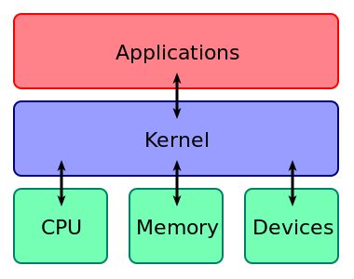
Kernel

Slide 12
System Calls

Slide 13
System Call
Definition: A “System call” provides an interface between the “process” and the “operating system”.
System calls allow user-level processes to request some services from the operating system, which process itself is not allowed to do.
When a process makes requests of the kernel, it is called a system call.
For example deleting a “system file” need administrative permission because it cannot be deleted directly.

Slide 14
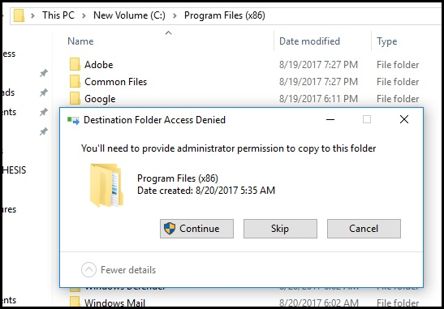
System Call: An Example
For example deleting or copying a file in windows drive need administrative permission because it cannot be deleted or copied directly can be thought to understand system call.

Slide 15
System Call: Services
All programs needing resources must use system calls.
Services Provided by System Calls :
  Process creation and management
  Main memory management
  File Access, Directory and File system management
  Device handling(I/O)
  Protection
  Networking, etc.

Slide 16
System Call: Types of System Calls
There are 5 different categories of system calls –
  Process control: end, abort, create, terminate, allocate and free memory.
  File management: create, open, close, delete, read file etc.
  Device management
  Information maintenance
  Communication

Slide 17
Process management Techniques In An O.S

Slide 18
Process management Techniques in O.S
In the lectures to follow, we will look into following main concepts related to process management in an O.S:
Threads
Swapping
Scheduling

Slide 19
Threads

Slide 20
Threads
Definition: A thread is a method used by an operating system in which a single process is broken into other small individual processes.
Each small individual process is also a thread and it belongs to same single process and is handled independently by O.S.

Slide 21
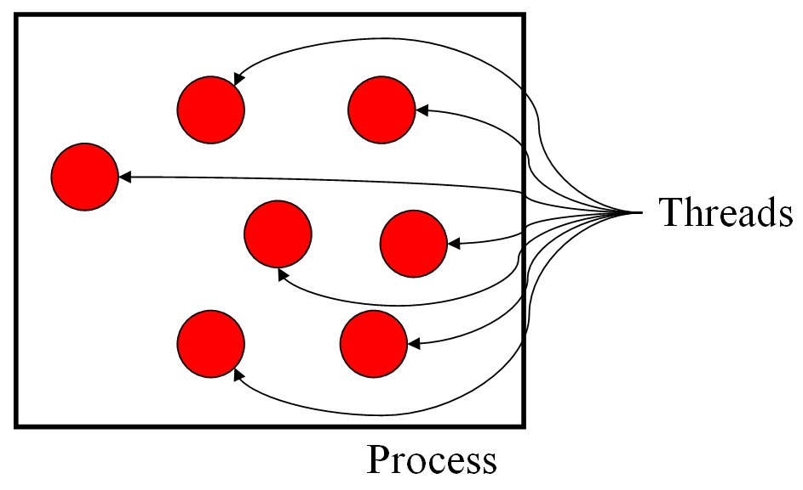
Threads
Each thread belongs to exactly one process and no thread can exist outside a process to which it belongs.
Threads provide a way to improve application performance through parallelism.
A thread is a single sequence stream within in a process.

Slide 22
Advantages of Threads
Handle multiple activities in many applications.
Threads are easier to create and destroy.
Performance is fast
Useful on systems with multiple CPU’s.

Slide 23
Threads: An example
Working on a document in M.S Word:
The first thread interacts with the user.
The second thread reformates the document.
The third thread writes the contents of word on the RAM to the disk.
Any other examples?

Slide 24
Types of Threads
Single threading: The ability of an OS to support one thread per process.
Multithreading: The ability of an OS to support multiple threads within a single process.

Slide 25
Processes Vs Threads
Similarities
Like processes threads share CPU and only one thread active (running) at a time.
Like processes, threads within a process execute sequentially.
Like processes, thread can create children.
And like process, if one thread is blocked, another thread can run.

Slide 26
Processes Vs Threads
Differences
Unlike processes, threads are not independent of one another.
Unlike processes, thread are designed to assist one another. Note that processes might or might not assist one another because processes may originate from different users.

Slide 27
Blocked and Ready
A thread is BLOCKED if it doesn't want the CPU, which might happen for several reasons, such as:
  The thread is sleeping.
  The thread is waiting for a message from another thread.
  The thread is waiting on a mutex (an algorithm or object used to negotiate mutual exclusion among threads) that some other thread owns.

Slide 28
Blocked and Ready
  A thread is READY if it wants a CPU but something else currently has it.
  If a thread currently has a CPU, then it's in the RUNNING state.
  Simply, a thread that's either READY or RUNNING isn't blocked.

Slide 29
Swapping

Slide 30
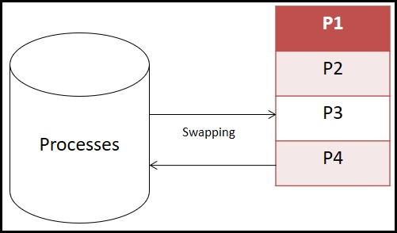
Swapping
Definition: Swapping consists of bringing each process in the memory, running it for a while and then putting it back on the disk.

Slide 31
Why we need Swapping?
When all of the processes in main memory(RAM) are in the Blocked state, the OS can suspend one process by putting it in the Suspend state and transferring it to disk.

Slide 32
Why we need Swapping?
The space that is freed in main memory can then be used to bring in another process.
It then brings back the old process.
Buffer and Virtual memory concept is involved.

Slide 33
Scheduling and Scheduler

Slide 34
Scheduling and Scheduler
Definition: When more than one process is runnable, the operating system must decide which one to run first. The part of the operating system concerned with this decision is called the scheduler, and algorithm it uses is called the scheduling algorithm.

Slide 35
Types of Scheduler
Types of Scheduler
Primary Scheduler
Secondary Scheduler

Slide 36
Scheduling and Scheduler: Primary Scheduler
Primary Scheduler
Runs threads with the highest priority.
It then compares their priority and assigns resources to them, depending on their priority.
Threads with the highest priority will be executed for the current time slice.
With two or more threads with the same priority, they are put on a stack to allow each run on a given time slice.

Slide 37
Scheduling and Scheduler: Secondary Scheduler
Secondary Scheduler
It is responsible for increasing the priority of non-executing threads.
It is important that those low-priority threads are given a chance to run on the operating system and this is the function of this type of scheduler.

Slide 38


